Slide 1
Have Questions?
We have answers!
Tish Harris Liang Liao
Meg Walker Rick Bradley

Slide 2
Let’s Get to Know one another!
It Takes a Village!
We will answer the Top 10 Questions TVIs have sent us
AND
We may have questions for you!
Rick

Slide 3
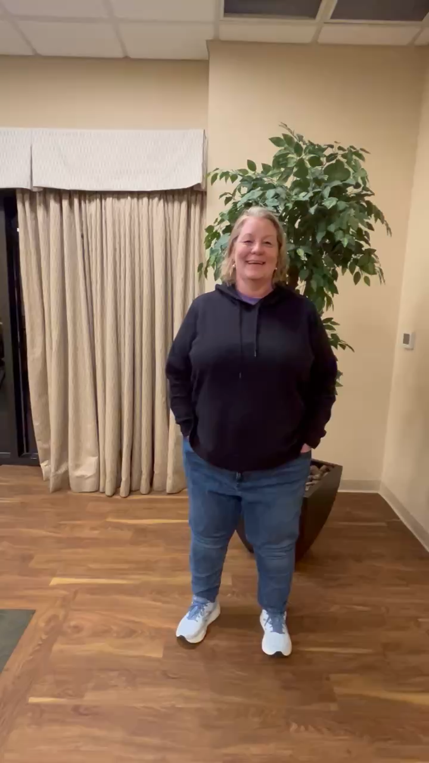

Slide 4
Question 1
What exactly is your role
and
how does it differ from mine as the TVI?

Slide 5
Together we help students succeed
VR Counselors
O&M
Student Team
What is the best part about your role?

Slide 6
Question 2
At what age
should I refer or connect
my student to VR?

Slide 7
Connect at age 14 or as soon as possible!
Two Case Types
PE=Potentially Eligible, ages14 thru 22nd b-day
  Limited to 5 Required Services, no application or plan, simply identify as having vision impairment
  Under the law, PE cannot provide technology, low vision exam, counseling and guidance for choosing career goal
VR=Vocational Rehabilitation-ages 14+ to adults-offers more!
  Assessment services, referral services, assistive technology, O&M, and personal assistance services, coaching and family services (mental health counseling) may be accessed
  May offer college assistance, higher level credential training
  The earlier we move students into VR and begin goal setting the more success we see.
  Both build rapport to prepare for transition to work or training or higher education
PLEASE INVITE US TO THE IEP MEETINGS!
  Send us reminders- the earlier the better!
Notes:
Rick and Liang
Explain 5 services in general terms- Liang PE and Rick VR

Slide 8
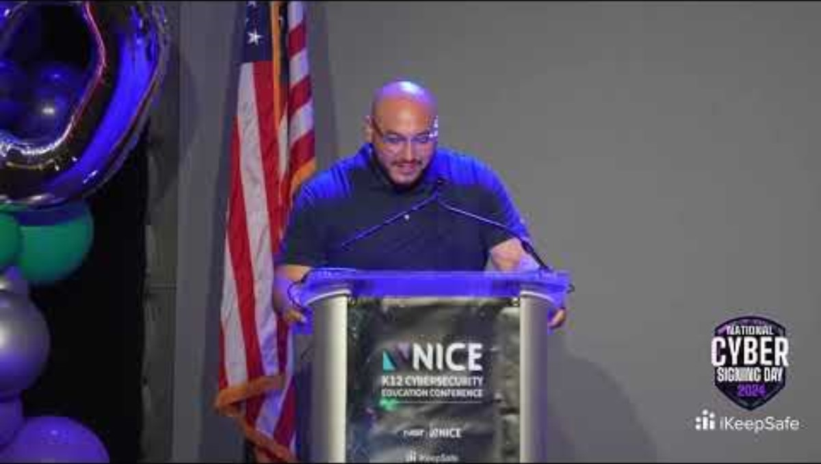
Notes:
Kaleb came to Leap into Linux with no tech experience

Slide 9
Question 3
What kinds of assessments do you perform
to determine career readiness and independent living needs?

Slide 10
Student programs vary
O&M-assess current skill level individually – separate from school O&M
  On campus skills
VRC role=Under VR look at
  Job readiness- Exploration, identify skills needed for success and help develop them, identify careers of interest
  Look at technology- AT assessment close to graduation
Notes:
Meg, Rick and Liang

Slide 11
Question 4
What job-readiness skills do you expect students to have learned in school before they meet you?
VRCs- we teach these-many students don’t start with these
O&M-can be taught at any age
Student team- this is our specialty- these are embedded into EVERY program
Notes:
Rick and Liang start, then Meg, then Tish

Slide 12
Video from a DBVI parent!

Slide 13
Question 5
How can we work together to prepare my students and families while they’re still in school to transition in VR services?

Slide 14
Identify students early and let DBVI know!
  No wrong door
  Once student hits 14, anyone in their life can make referral to any DBVI staff or office (parent, teacher, preacher, doctor, school staff that knows student, or students can be self-referral, etc.)
  We will do a warm hand off to the appropriate regional office
  TVIs- Follow up with us or ask parents if they have been contacted and follow back up with us
Invite us to IEP meetings-reach out early if possible
Notes:
Meg

Slide 15
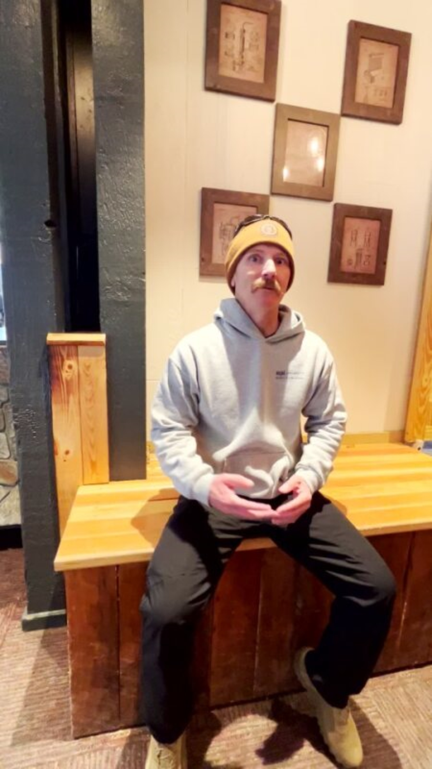
Video from parent of a student new to DBVI programs

Slide 16
Question 6
What programs, summer experiences can you connect students with?
Notes:
Rick and Liang- variety of programs

Slide 17
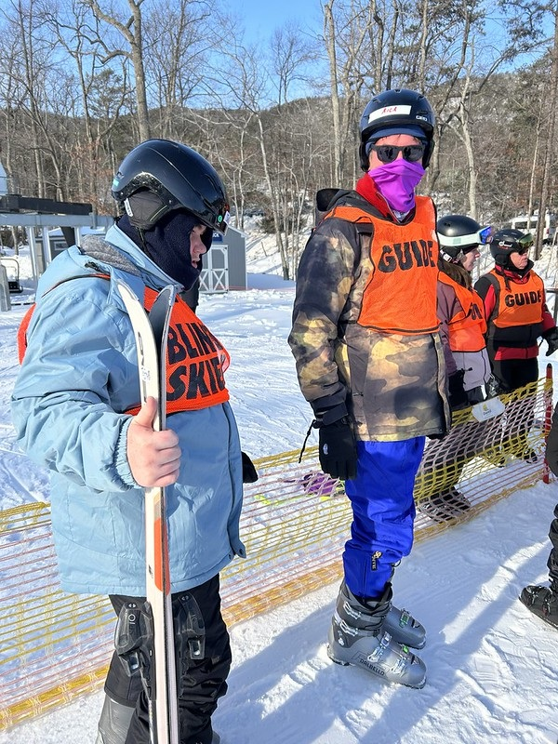
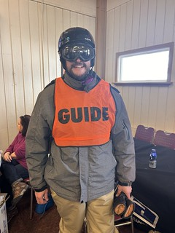

Slide 18
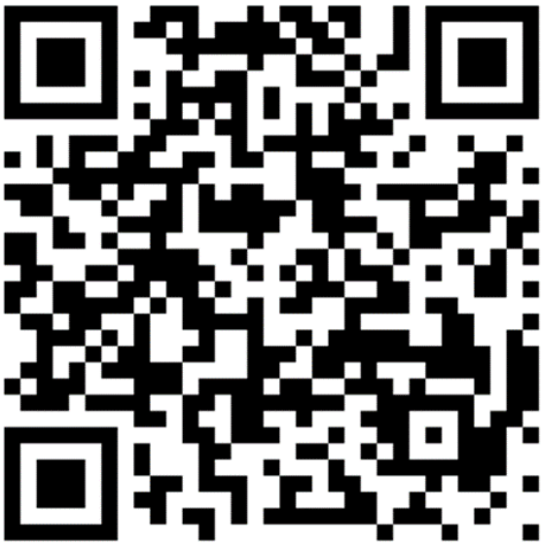
DBVI Student & Transition Webpage
Notes:
Tish

Slide 19
Question 7
How does Work Based Learning work?
  In person and virtual opportunities
  Some great examples from our VRCs
How can the counselor support a student after connecting them with a job experience?
  Counseling and guidance provided to discuss employer feedback, student experiences and challenges, and next steps
  Resources for job placement assistance if student moves to VR services
Notes:
Rick and Liang- Explain what work-based learning is- paid or unpaid working opportunities that can happen during school year or summer

Slide 20
Question 8
How do you collaborate with Orientation & Mobility (O&M) instructors when jobs or programs involve independent travel?
Notes:
Meg

Slide 21
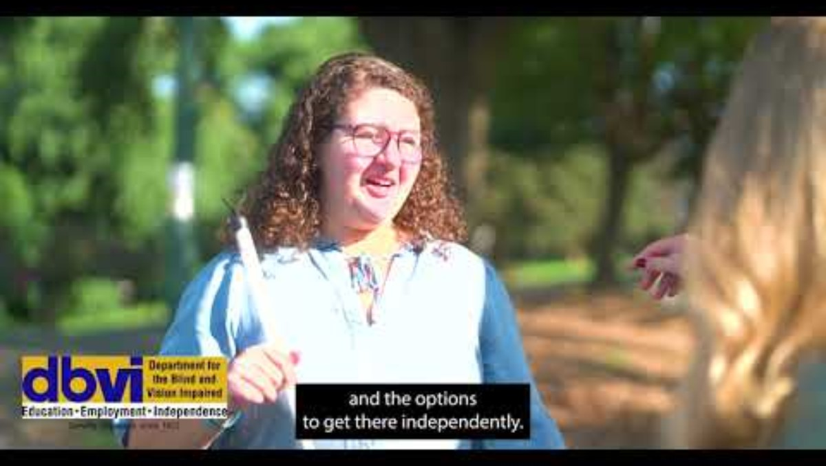

Slide 22
Question 9
What is the process for students to get assistive technology for work or college?

Slide 23
Schools are mandated to provide tech needed for schoolwork under an IEP- beyond that:
If open to VR then Counselors can:
  Refer for an assistive technology assessment through rehab tech engineering for AT needs for college, post secondary credential training or employment needs
  Request tutoring on specific Assistive Technology based on needs to move on to employment, higher education or post-secondary opportunities
Notes:
Rick and Liang

Slide 24
Question 10
How does the VR program communicate with students once they are enrolled in
VR services?

Slide 25
Communication!
Town Hall, Jump into Summer, Fall into Success
Prior to age 18
  We communicate with both student and parents by email, phone, text
  Contact with TVI or Special Ed Coordinator to schedule a visit either in person or virtually
  After age 18 we must have a signed consent to include the parent unless parent has legal guardianship
  TVI’S, COORDINATORS PLEASE REACH OUT TO US!
  When DBVI is present at the IEP meeting, everyone is on board to help the student to apply for programs, get a customized plan for success, and help throughout the process.
Notes:
Rick and Liang- elaborate on the WE
Meg- at end if forgotten please add it in

Slide 26
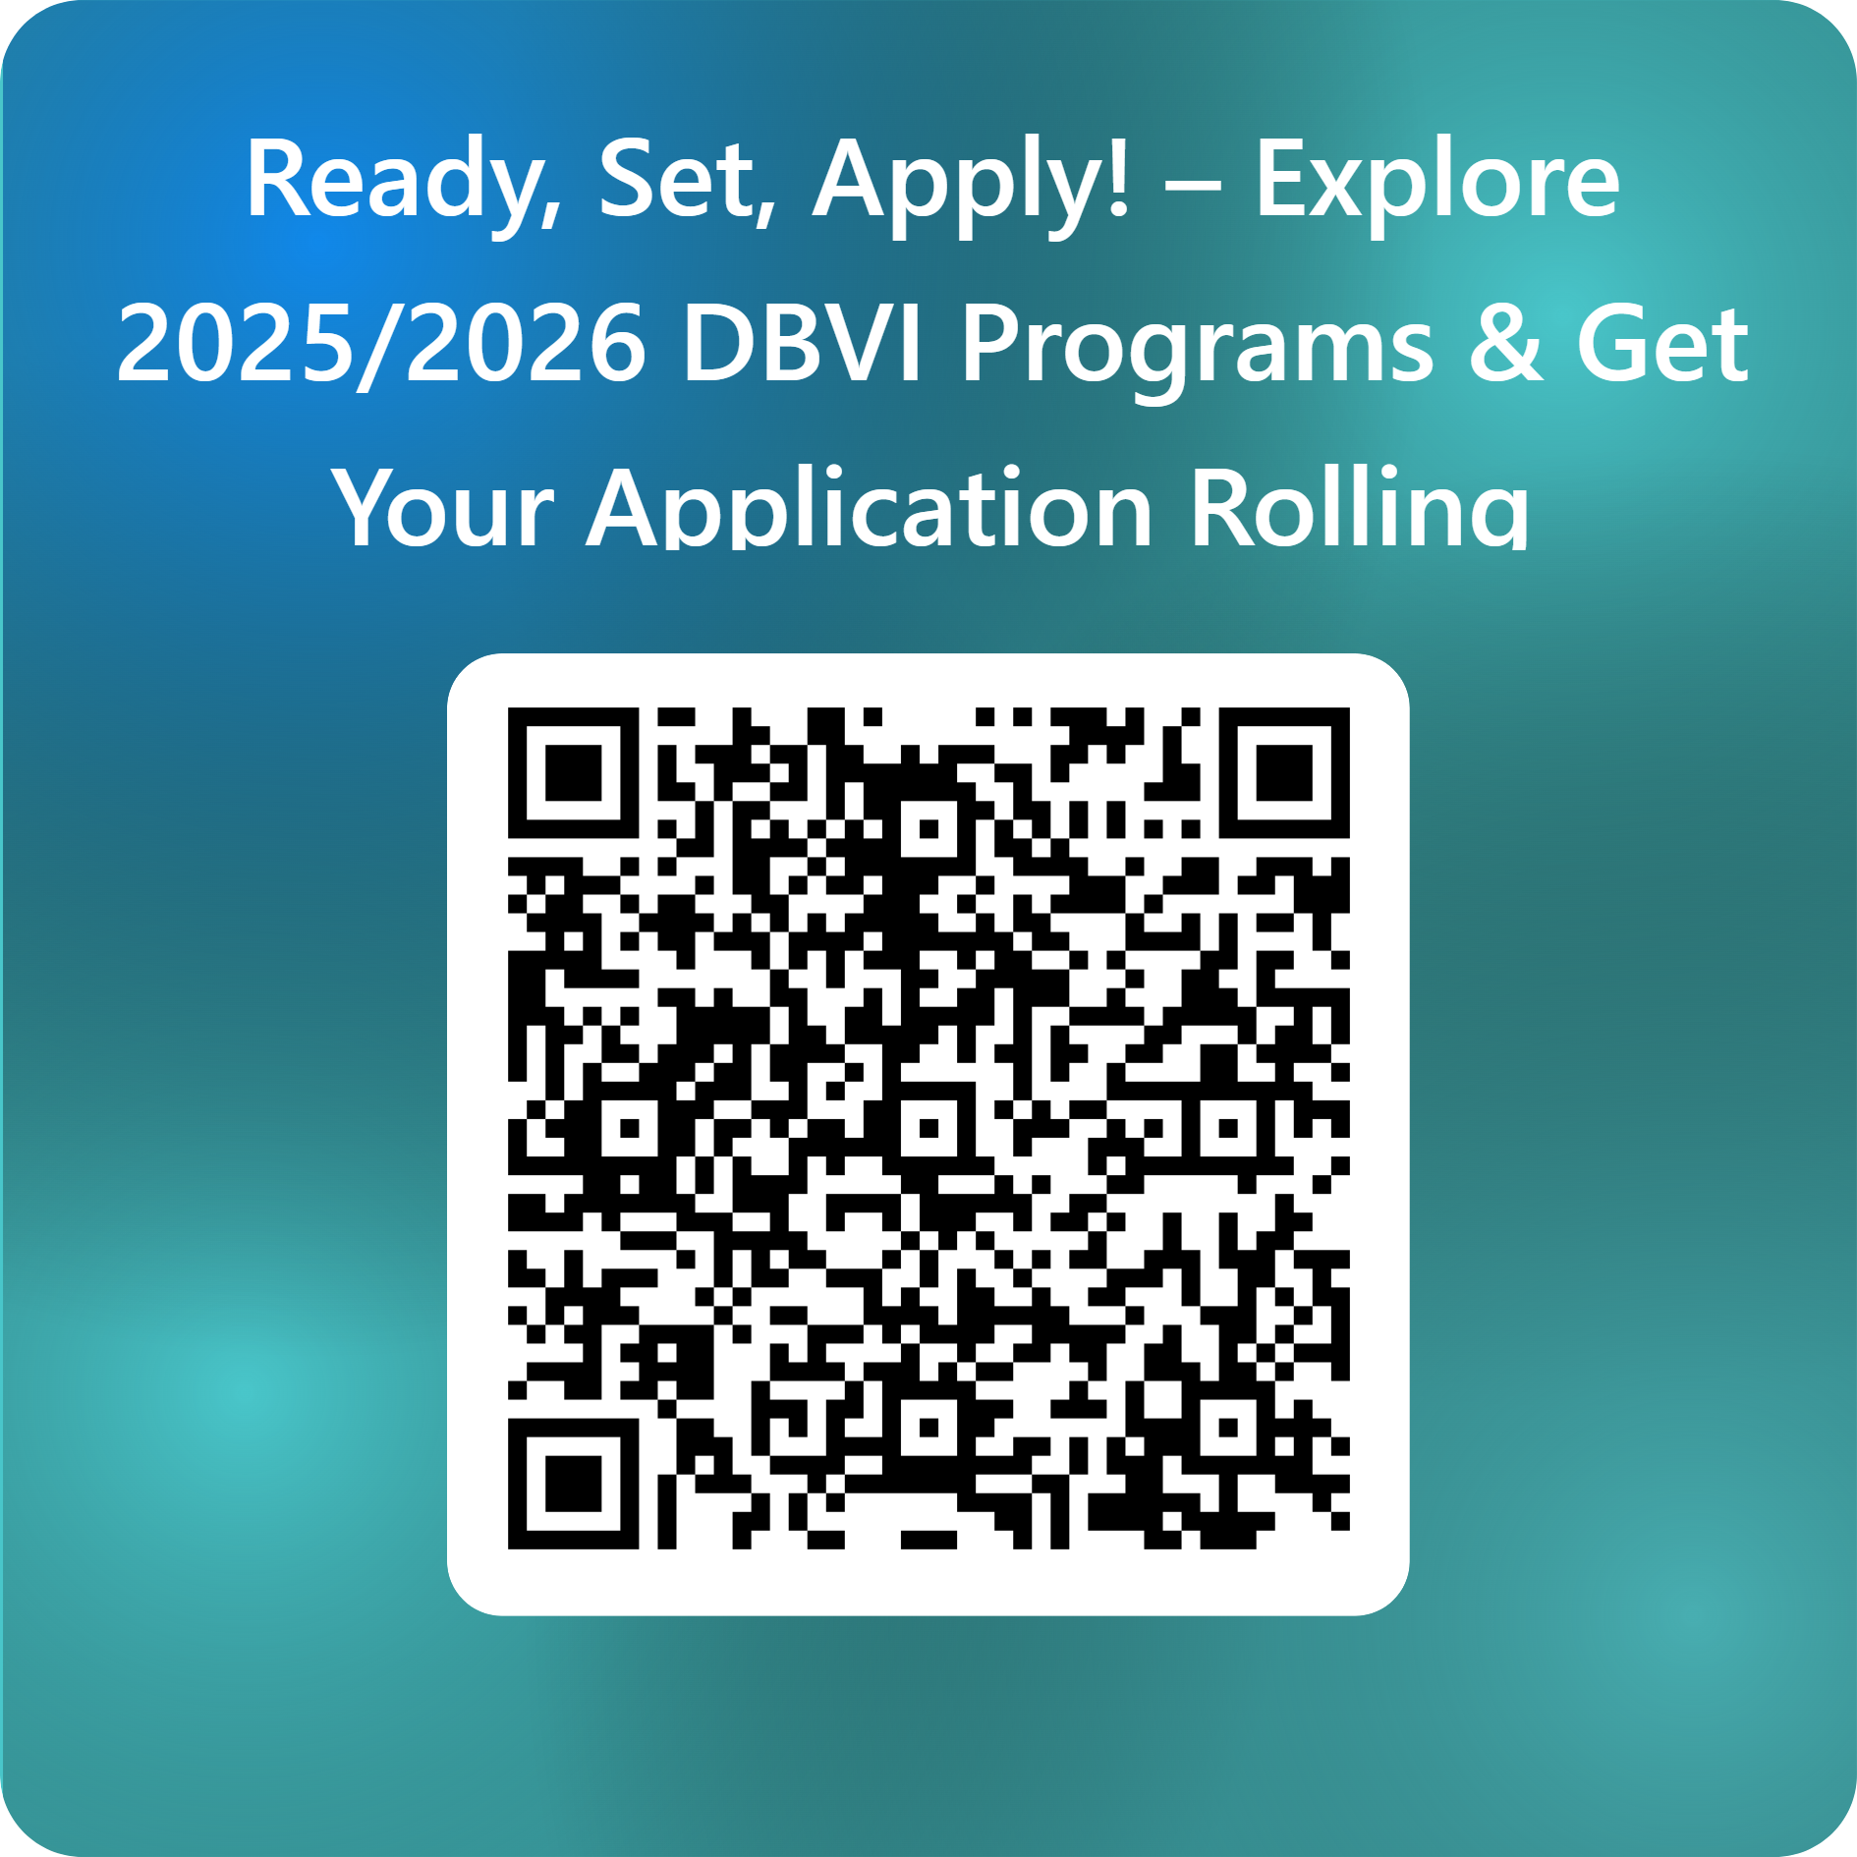
Notes:
Rick and Liang- application process going along with counseling, trying something new- don’t wait until the last minute since some programs have limited size cohorts- helps students determine what they like and what they don’t like
Tish- Family programs in spring and fall are great starters
Meg- these are rolling and you can apply at any time- remind TVIs our job is to help you

Slide 27
Bonus Question for You!
Do you have students who qualify
but are not participating yet?
How can we help?
If the answer is YES! Please connect with us after this session or during the conference
Notes:
Rick and/or Liang

Slide 28
Questions? Reach out!
Tish.Harris@dbvi.virginia.gov
Meg.Walker@dbvi.virginia.gov
Rick.Bradley@dbvi.virginia.gov
Liang.Liao@dbvi.virginia.gov

